Slide 1



Service Assurance
Carlos Gonçalves, NEC
Maryam Tahhan, Intel

Slide 2
Legal Disclaimers
Intel technologies’ features and benefits depend on system configuration and may require enabled hardware, software or service activation. Performance varies depending on system configuration. No computer system can be absolutely secure. Check with your system manufacturer or retailer or learn more at intel.com.
Axxia, Intel, the Intel logo, Intel Atom, Intel Core, Intel. Experience What’s Inside, the Intel. Experience What’s Inside logo and Xeon are trademarks of Intel Corporation in the U.S. and/or other countries.
© 2016 Intel Corporation. All rights reserved. *Other names and brands may be claimed as property of others.

Slide 3



Introduction
“Data Centres are powering our everyday lives. Organizations lose an average of $138,000 for one hour of downtime.” [1].
Telco and Enterprise alike are asking how they get and provide Service Assurance, QoS and provide SLA’s on the platform and services when deploying NFV.
It is vital to monitor systems for malfunctions or misbehaviours that could lead to service disruption and promptly react to these faults/events to minimize service disruption/downtime.
Notes:
As the world becomes increasingly dependent on the internet, data centers have come to power our everyday lives.
Knowing this and taking 2 things into account, firstly the transition to SDN/NFV and secondly the cost of Data center downtime has left the telco and enterprise industries asking how they can get and provide SA, QOS and provide SLA’s on the platform and services when deploying nfv.
If fixed function appliances are going to be replaced by virtualized appliances the service levels, manageability and service assurance needs to remain consistent or improve on what is available today
Lack of service assurance in NFV is a barrier in the path to adoption and deployment
A key part of breaking down this barrier includes expanding the amount of data available from the platform (e.g. DPDK statistics), and improving alarming functionality in OpenStack Aodh

Slide 4
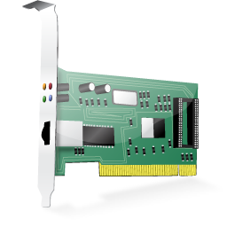
Use case Example
Compute node DPDK interface monitoring for Host link status and switches from active to standby service when the link goes down.
Compute Node 1
Controller
Compute Node 2
VNF
collectd
ceilometer
aodh
VNF
OVS With DPDK
OVS
VNF
= Active
VNF
= Standby
Notes:
0 & 1 Collectd is monitoring DPDK physical port link status and pushing samples to ceilometer on the controller.
2 aodh is configured to monitor the link status meter and alarm when link status is detected as gone down

Slide 5
Use case Example
Compute node DPDK interface monitoring for Host link status and switches from active to standby service when the link goes down.
localhost-port.0-link_status != 0
Compute Node 1
Controller
Compute Node 2
VNF
collectd
ceilometer
aodh
VNF
OVS With DPDK
OVS
VNF
= Active
VNF
= Standby
Notes:
0 & 1 Collectd is monitoring DPDK physical port link status and pushing samples to ceilometer on the controller.
2 aodh is configured to monitor the link status meter and alarm when link status is detected as gone down

Slide 6

Use case Example
Compute node DPDK interface monitoring for Host link status and switches from active to standby service when the link goes down.
localhost-port.0-link_status != 0
Compute Node 1
Controller
Compute Node 2
VNF
collectd
ceilometer
aodh
VNF
OVS With DPDK
OVS
VNF
= Active
VNF
= Standby
Notes:
0 & 1 Collectd is monitoring DPDK physical port link status and pushing samples to ceilometer on the controller.
2 aodh is configured to monitor the link status meter and alarm when link status is detected as gone down

Slide 7
Use case Example
Compute node DPDK interface monitoring for Host link status and switches from active to standby service when the link goes down.
localhost-port.0-link_status != 0
Compute Node 1
Controller
Compute Node 2
VNF
collectd
ceilometer
aodh
VNF
OVS With DPDK
OVS
X
VNF
= Active
VNF
= Standby
Notes:
0 & 1 Collectd is monitoring DPDK physical port link status and pushing samples to ceilometer on the controller.
2 aodh is configured to monitor the link status meter and alarm when link status is detected as gone down

Slide 8
Use case Example
Compute node DPDK interface monitoring for Host link status and switches from active to standby service when the link goes down.
localhost-port.0-link_status == 0
Compute Node 1
Controller
Compute Node 2
VNF
collectd
ceilometer
aodh
VNF
OVS With DPDK
OVS
X
VNF
= Active
VNF
= Standby
Notes:
0 & 1 Collectd is monitoring DPDK physical port link status and pushing samples to ceilometer on the controller.
2 aodh is configured to monitor the link status meter and alarm when link status is detected as gone down

Slide 9
Use case Example
Compute node DPDK interface monitoring for Host link status and switches from active to standby service when the link goes down.
Compute Node 1
(out of service)
Controller
Compute Node 2
VNF
collectd
ceilometer
aodh
VNF
OVS With DPDK
OVS
X
VNF
= Active
Notes:
0 & 1 Collectd is monitoring DPDK physical port link status and pushing samples to ceilometer on the controller.
2 aodh is configured to monitor the link status meter and alarm when link status is detected as gone down

Slide 10
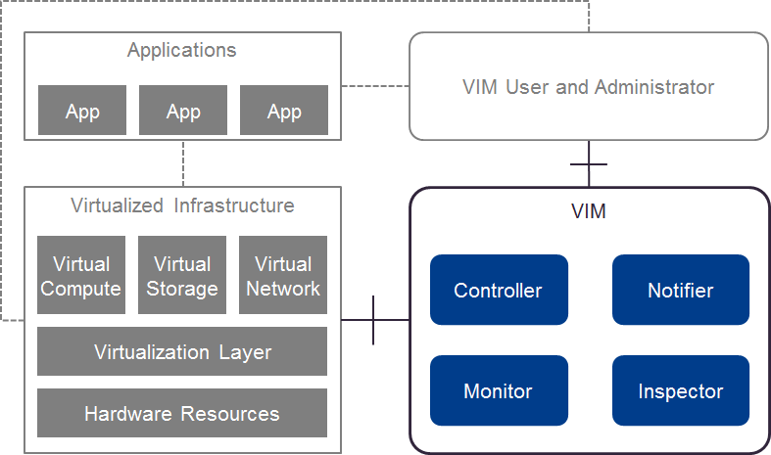
Doctor
Project in OPNFV working on building an open-source NFVI fault management and maintenance framework to ensure Telco VNFs availability in fault and maintenance events
Identify requirements
Gap analysis
Implementation work in upstream
Integration and testing
Consistent Resource State Awareness
Immediate Notification
Extensible Monitoring
Fault Correlation

Slide 11
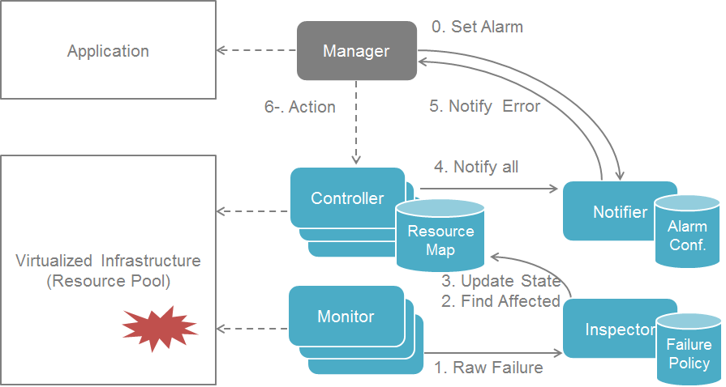
Doctor: fault management use case

Slide 12
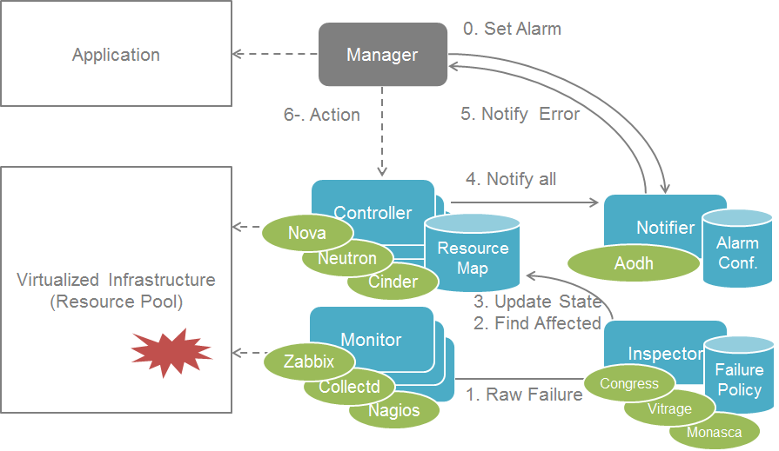
Doctor: mapping to the OpenStack ecosystem

Slide 13
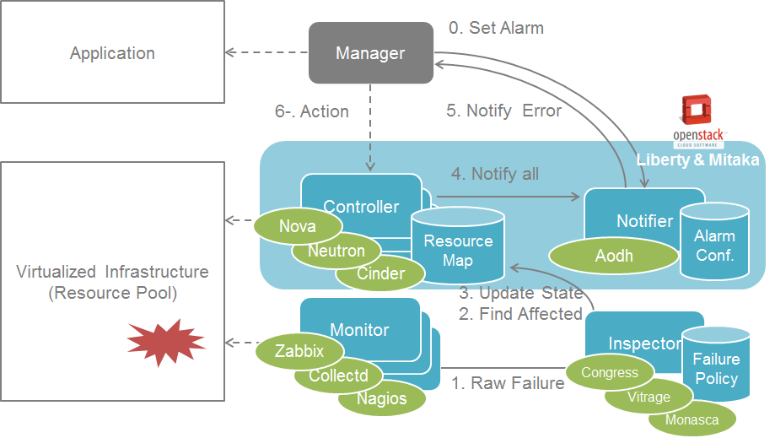
Doctor: focus of initial contributions
Consistent Resource State Awareness
Immediate Notification

Slide 14
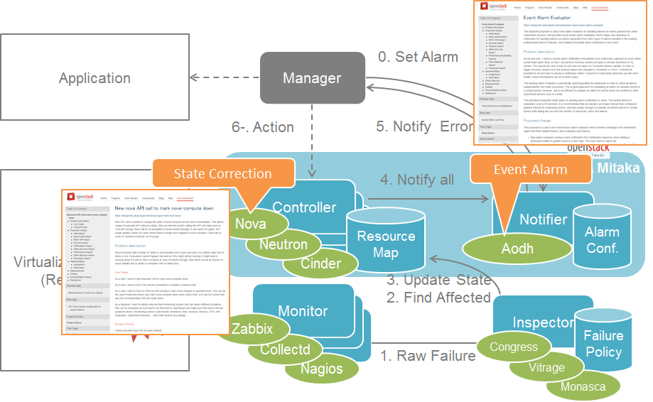
Doctor: focus of initial contributions
Consistent Resource State Awareness
Immediate Notification

Slide 15
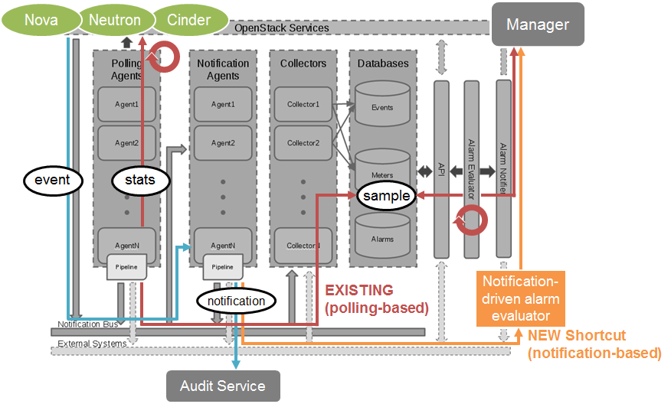
Immediate event alarming

Slide 16
Doctor: focus of initial contributions
Consistent Resource State Awareness
Immediate Notification

Slide 17
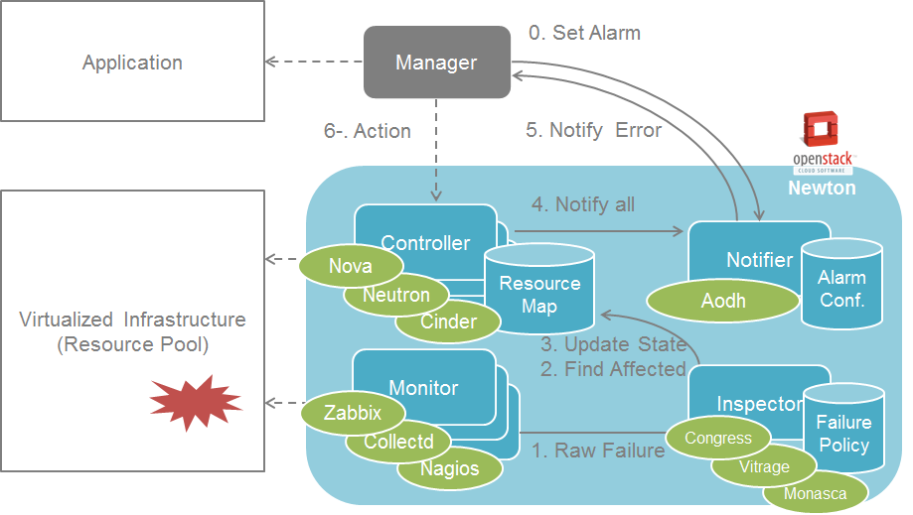
Doctor: extending contribution focus
Consistent Resource State Awareness
Immediate Notification
Extensible Monitoring
Fault Correlation

Slide 18
Doctor blueprints in OpenStack
Project | Blueprint | Spec Drafter | Developer | Status
Aodh | Event Alarm Evaluator | Ryota Mibu (NEC) | Ryota Mibu (NEC) | Completed (Liberty)
Nova | New nova API call to mark nova-compute down | Tomi Juvonen (Nokia) | Roman Dobosz (Intel) | Completed (Liberty)
 | Support forcing service down | Tomi Juvonen (Nokia) | Carlos Goncalves (NEC) | Completed (Liberty)
 | Get valid server state | Tomi Juvonen (Nokia) | Tomi Juvonen (Nokia) | Completed (Mitaka)
 | Add notification for service status change | Balazs Gibizer (Ericsson) | Balazs Gibizer (Ericsson) | Completed (Mitaka)
Congress | Push Type Datasource Driver | Masahito Muroi (NTT) | Masahito Muroi (NTT) | Completed (Newton)
 | Adds Doctor Driver | Masahito Muroi (NTT) | Masahito Muroi (NTT) | Completed (Newton)

Slide 19


SFQM Overview
Develop the utilities and libraries in DPDK to support:
  Measuring Telco Traffic and Performance KPIs. Including:
    Packet Delay Variation.
    Packet loss.
  Monitoring the performance + status of the DPDK interfaces.
  Detecting and reporting violations that can be consumed by VNFs and higher level fault management systems.
Enable provisioning, monitoring and service impacting fault detection infrastructure on the Platform
Notes:
Scope is the NFVI.
Lack of service assurance in NFV is a barrier in the path to adoption and deployment
If fixed function appliances are going to be replaced by virtualized appliances the service levels, manageability and service assurance needs to remain consistent or improve on what is available today
Provisioning, monitoring and service impacting fault detection for infrastructure platforms
Enable Reactive and Pro-active fault detection, fault reporting and support corrective actions
Support current Industry Standard FCAPS, Platform Telemetry and flow Telemetry interfaces
Support Open Interoperable Interfaces to integrate with High Availability, NFV MANO, and Service Assurance software elements
Extend Reliability (RAS) to include Software Fault Detection in addition to Hardware Faults

Slide 20
Contributions to Open Source Projects
Collectd
DPDK 2.0
DPDK 2.1
DPDK 2.2
DPDK 16.04
Callback API
RX/TX timestamping sample app.
Extended NIC stats for ixgbe.
proc_info
Extended NIC stats for igb, i40e and VFs.
Extended NIC API Alignment across drivers.
DPDK KeepAlive
Primary process liveliness check.
dpdkstat plugin – pull request
Ceilometer plugin.
Measure packet latency through DPDK
Retrieve statistics directly from NIC registers.
Detect DPDK application thread failure.
Detect DPDK primary process liveliness.
Relay DPDK interface stats and status back to ceilometer.
Notes:
FROM AN INTEL SCOPE IS BEYOND DPDK,

Slide 21
Contributions to Open Source Projects
Open vSwitch
Collectd
Collectd
DPDK 16.07
DPDK 16.11
ID based Extended NIC stats API
DPDK Keep Alive exposing core status through POSIX shared Memory Object
DPDK Link status/KA plugin
Extended Stats API Implementation for vhost PMD. *
Improved primary/secondary DPDK process interaction *
Extend the Extended NIC stats API to retrieve Last cleared time for stats as well as average and peak bit rate. *
Extend the Extended NIC stats API to retrieve statistical Latency for packets. *
OVS extended NIC stats API integration. *
OVS Keep Alive Integration.
OVS plugin to retrieve interface and flow stats.
CMT plugin to report Cache Occupancy on a per Resource Monitoring ID (RMID) basis.
Integration with collectd SNMP Plugin.
Extended/ Improved Extended NIC stats & DPDK KA APIs.
* Still in planning
Notes:
CMT – Cache Monitoring Technology
Intel Resource Director Technology

Slide 22
Intel® Resource Director Technology
Cache Monitoring Technology (CMT)
Cache Allocation Technology (CAT)
Memory Bandwidth Monitoring (MBM)
Core
Core
Core
Core
app
Core
Core
app
Core
Core
app
Core
app
app
app
app
app
app
Last
Level
Cache
Last
Level
Cache
Last
Level
Cache
DRAM
Identify misbehaving application and reschedule according to priority
Cache Occupancy reported on a per Resource Monitoring ID (RMID) basis
DRAM
Last Level Cache partitioning mechanism enabling the separation of an application
Misbehaving threads can be isolated to increase determinism
DRAM
Monitors Memory Bandwidth consumption on per thread/core/app basis
Shares common RMID architecture
Provides insight into second order of shared resource contention
Key Technologies for Improved Visibility and Performance Determinism

Slide 23
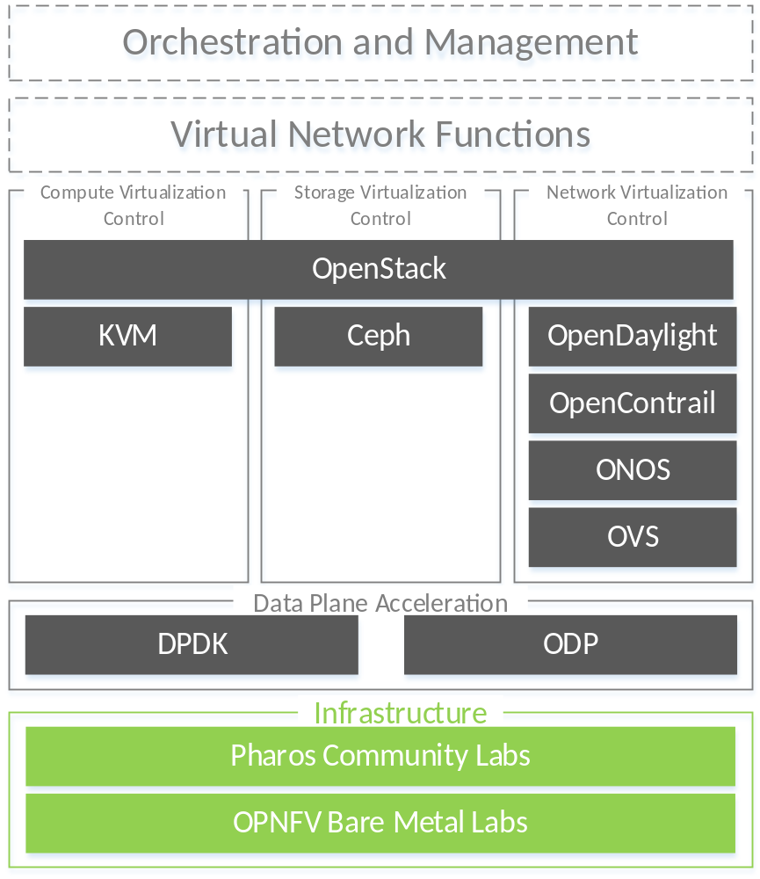
OPNFV Software Stack based on Brahmaputra

Slide 24
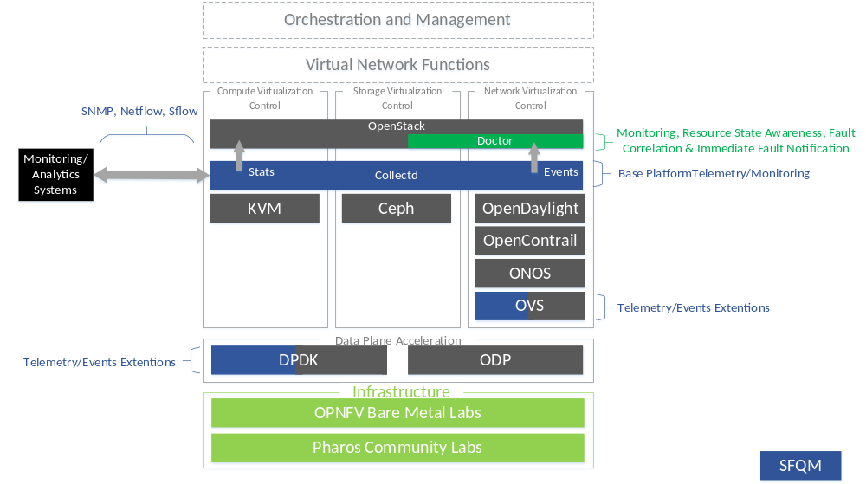
OPNFV SW Stack based on Brahmaputra + SA Ingredients

Slide 25
SFQM + Doctor
Ceilometer
VM
collectd
RX
TX
1. Read
OVS With DPDK
collectd
dpdkstat
Plugin
collectd
4. Pass Values
collectd Ceilometer Plugin
5. Post Values
2. Get stats
RX
TX
3. Dispatch Values

Slide 26
Summary
We would like to hear from you if you have any additional requirements or if you are interested in consuming this work.
Call to Action: Come join us in Doctor and SFQM to help pave the Fault management path in OPNFV.

Slide 27
Cloud Ready NFV Platform
Open Stack Infrastructure SA
Standard Open APIs
Corrective
Action
Monitoring/Analytics
Systems
Slow Path
Periodic Pull
5mins-15mins
Intel Components
MANO
Local
Corrective
Action
NFVI +VIM
HA Solution
Integration
Infrastructure SA
Open Fault Interface
Virtualised
Compute
Virtualised
Network
Virtualised
Storage
VIM
Fast Path
Triggers on events or counters
Hypervisor (incl Hard Real-time support)
Vitrage
Aodh
Reliability
Agent(s)
Standard Open APIs for Base Platform Resource Provisioning and Monitoring
Includes SNMP/sflow/NetFlow/IPFIX/collectd/ceilometer/EPA
Collectd openstack plugins
SNMP API
Syslog
sFlow/
NetFlow
Collectd
Ceilometer
Supporting MIBs [IF-MIB etc., Virtualization MIB]
Doctor
Congress
Nova
vSwitch counters
Hardware Resource Monitoring
HW Resource Health Detection(Watchdog/Heartbeat)
CPU/Mem/Utilization Counters
NIC counters
PMU counters
Neutron
VM Stall Detection/
RT Stall Detection
CAT/CMT/PQoS
Intel RAS Features
Fast Path Metrics
Cinder
Compute
Network
Storage

