Slide 1


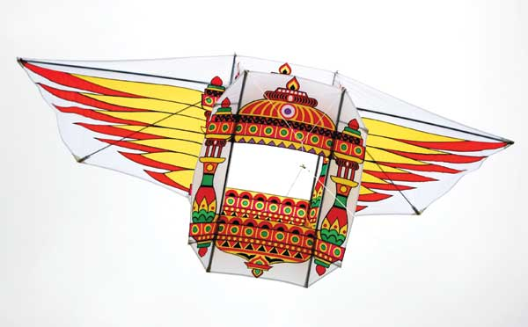

Results: Bonsai
Comparison to Uncompressed Methods
Comparison to Compressed Methods
Prediction Costs on the Arduino Uno

Slide 2
Dataset Statistics
Dataset | # Train | # Test | # Features
Chars4K-2 | 4,397 | 1,886 | 400
WARD-2 | 4,503 | 1,931 | 1,000
RTWhale-2 | 5,265 | 5,264 | 2,000
Eye-2 | 456 | 196 | 8,192
MNIST-2 | 60,000 | 10,000 | 784
USPS-2 | 7,291 | 2,007 | 256
CIFAR10-2 | 50,000 | 10,000 | 400
CUReT-61 | 4,204 | 1,403 | 610
MNIST-10 | 60,000 | 10,000 | 784
Chars4K-62 | 4,397 | 1886 | 400
Bing L3/L4 | 704,841 | 123,268 | 50

Slide 3
Comparison to Uncompressed Methods
Compressed :
Bonsai
Uncompressed :
GBDT
kNN
RBF-SVM
Neural Nets

Slide 4
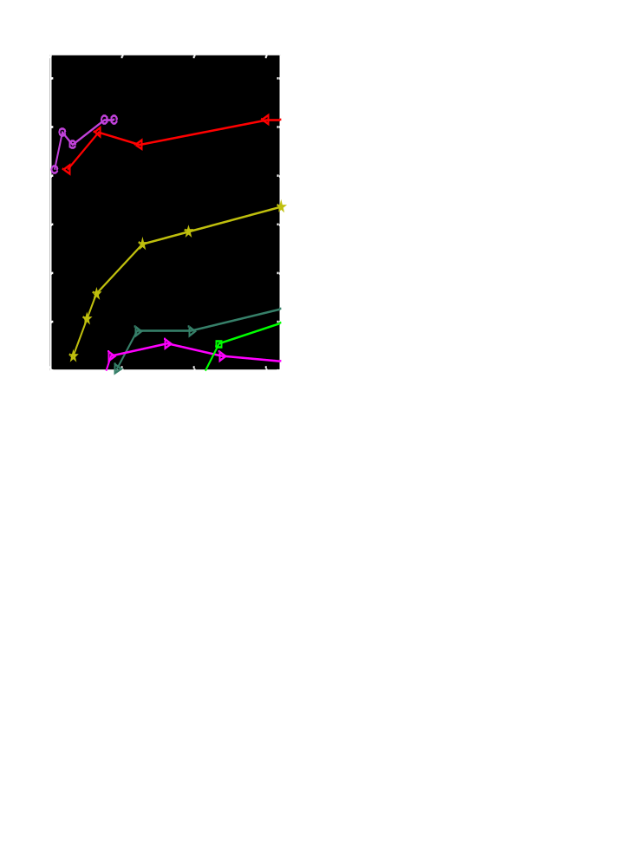
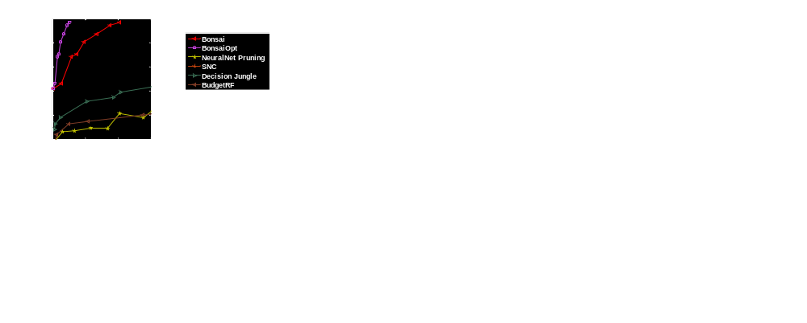
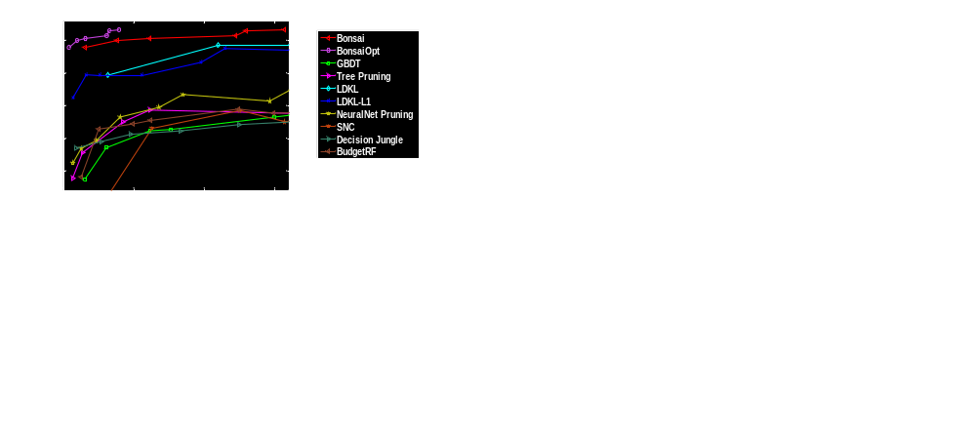
Prediction Accuracy vs Model Size

Slide 5
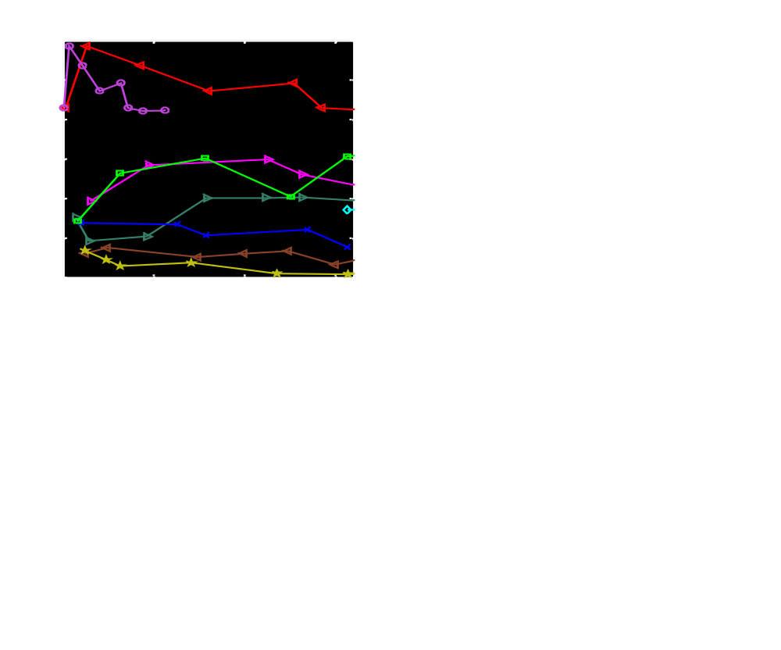

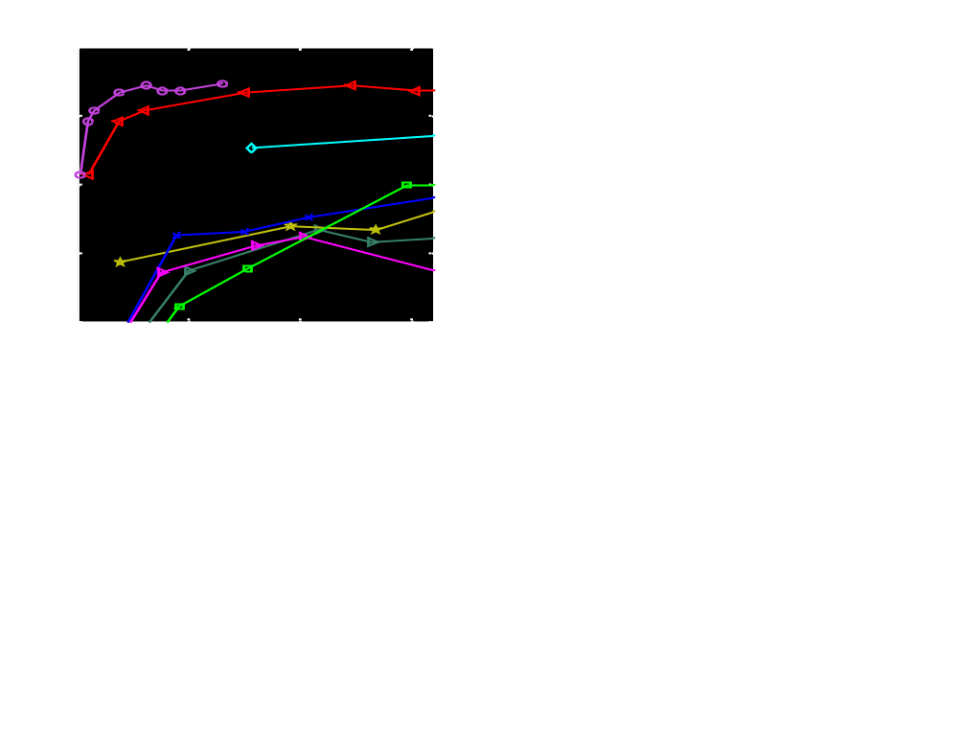
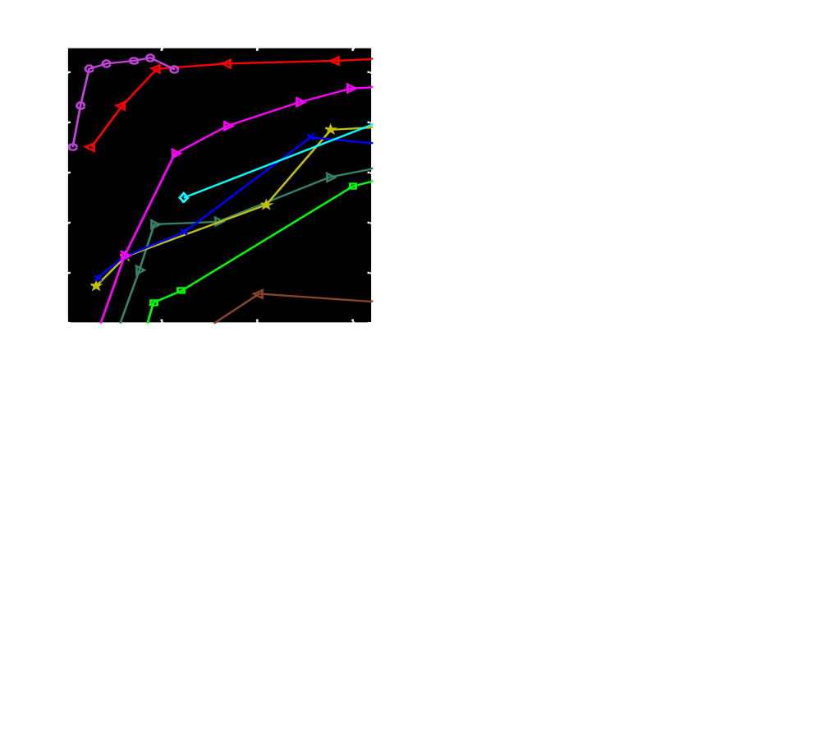
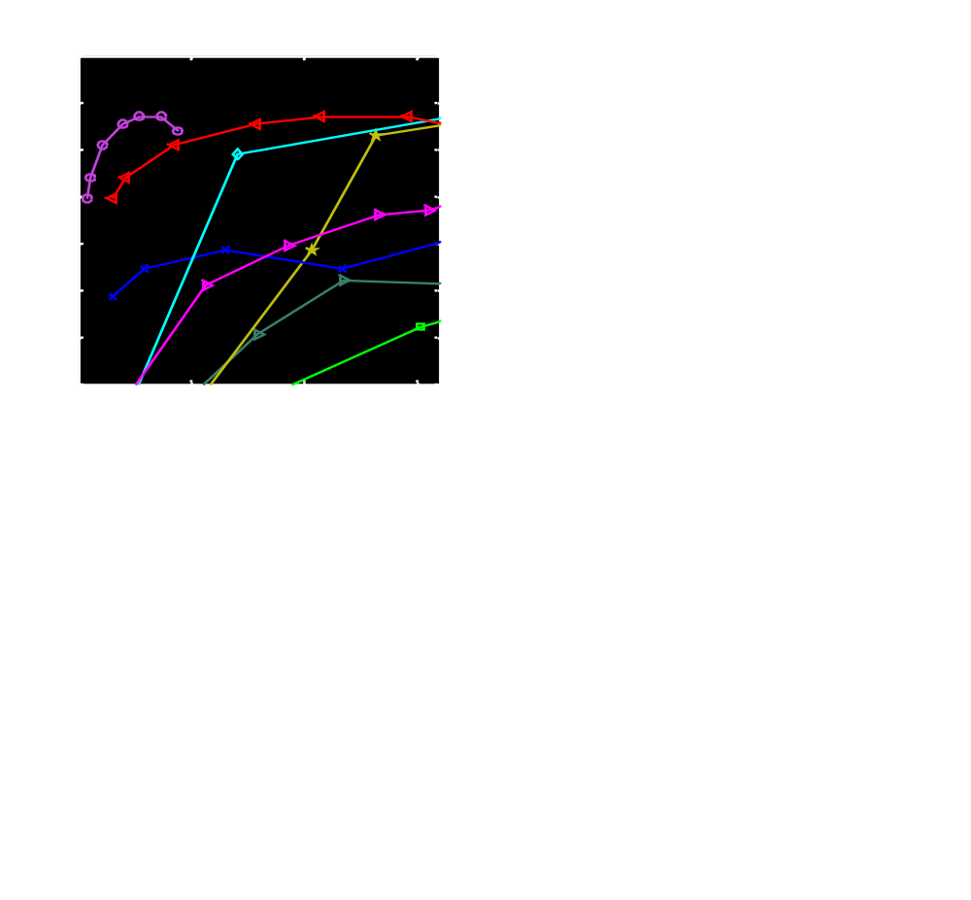
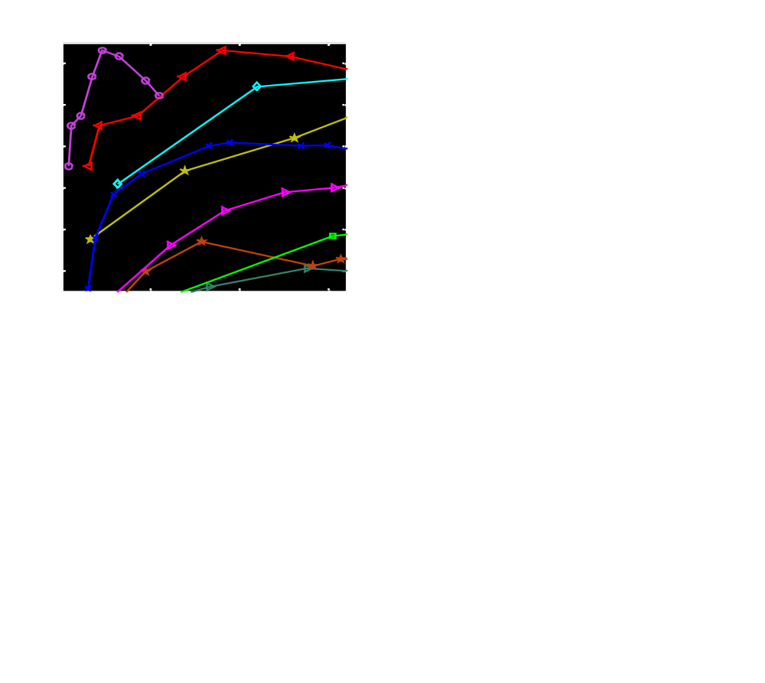
Prediction Accuracy vs Model Size

Slide 6
Prediction Costs on the Arduino Uno
Accuracy (%)
Pred Time (ms)
Pred Energy (mJ)
2187
1312
Eye-2
521
313
RTWhale-2
Bonsai Linear LDKL
NeuralNet Cloud-GBDT

Slide 7
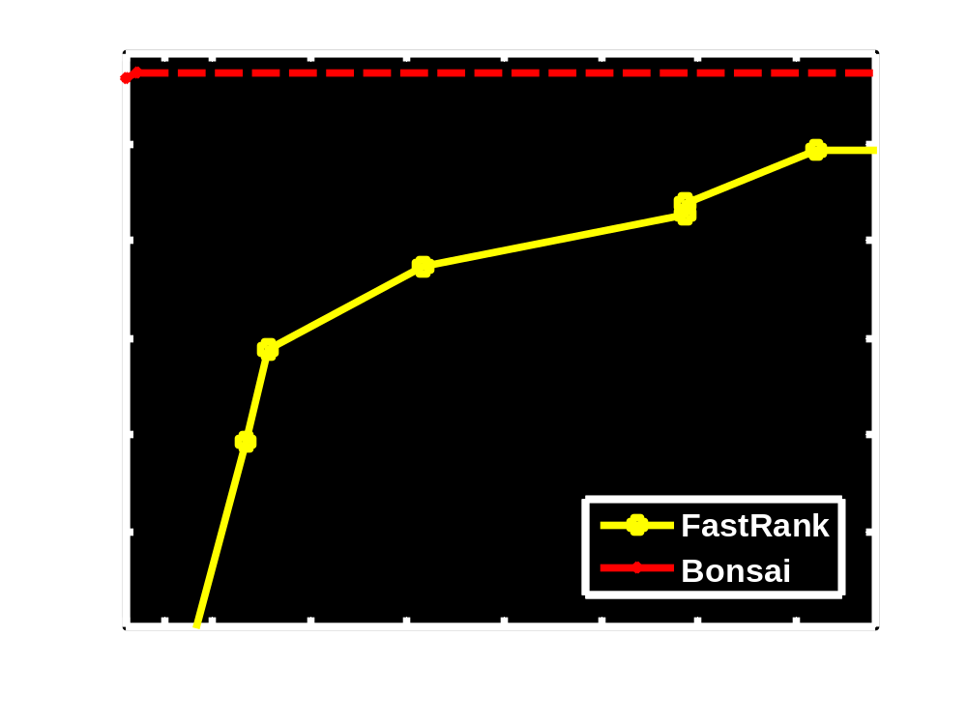
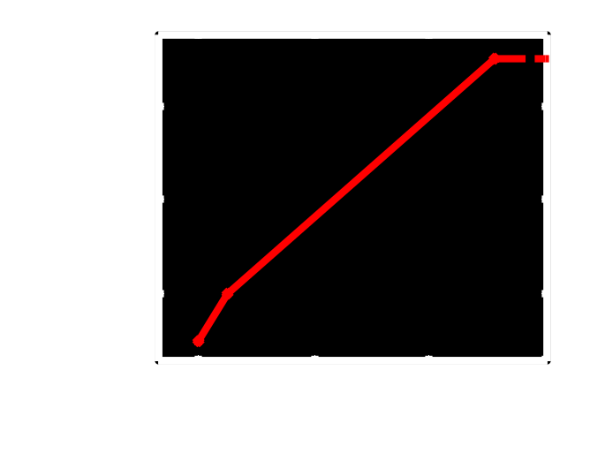
Bing L3/L4 Ranker Results

